Slide 1
Veera Reddy Koppula
DSC530-T301 Data Exploration and Analysis (2221-1)
Week 12: Term Project

Slide 2
Data Set – Kaggle Auto Mobile Data set - https://www.kaggle.com/toramky/automobile-dataset/version/2
Context
This dataset consist of data From 1985 Ward's Automotive Yearbook. Here are the sources
Sources:
1) 1985 Model Import Car and Truck Specifications, 1985 Ward's Automotive Yearbook. 2) Personal Auto Manuals, Insurance Services Office, 160 Water Street, New York, NY 10038 3) Insurance Collision Report, Insurance Institute for Highway Safety, Watergate 600, Washington, DC 20037
Content
This data set consists of three types of entities: (a) the specification of an auto in terms of various characteristics, (b) its assigned insurance risk rating, (c) its normalized losses in use as compared to other cars. The second rating corresponds to the degree to which the auto is more risky than its price indicates. Cars are initially assigned a risk factor symbol associated with its price. Then, if it is more risky (or less), this symbol is adjusted by moving it up (or down) the scale. Actuarians call this process "symboling". A value of +3 indicates that the auto is risky, -3 that it is probably pretty safe.
The third factor is the relative average loss payment per insured vehicle year. This value is normalized for all autos within a particular size classification (two-door small, station wagons, sports/speciality, etc…), and represents the average loss per car per year.
Note: Several of the attributes in the database could be used as a "class" attribute.

Slide 3

This data set consists of three types of entities:
(a) Technical specs of an auto in terms of various characteristics
(b) Automobile assigned insurance risk rating
(c) Normalized/Depreciation losses in use as compared to other cars
Symbolling rating: It is a degree to which autos are marked based on the risk and price index. It could go up and down. It’s also referred by actuaries/insurance auditors as "symbolling"
Normalized losses: Depreciation losses in use as compared to other cars
Make: Manufacturer name
fuel-type: Fuel type uses by auto. Gas or Diesel
Aspiration: Naturally aspirated engine or turbo charges/super charged
Num-of-doors: Number of doors to the automobile
Body-style: Sedan/Coupe/SUV/Hatchback/Hardtop...etc
Drive-wheels: Front wheel drive, rare wheel drive, all wheel drive
Engine-location: Location of engine
Wheelbase: Length of the car from front wheel to rare wheel
Length: Length of the car from bumper to bumper
Width: Width of the car side to side
Height: Hight of the car from ground to roof
Curb-weight: Empty vehicle weight with fuel
Engine-type: Engine type, dual overhead, single overhead cams, etc
Num-of-cylinders: Number of cylinders in the engine 4,6,8 or 12
Engine-size: Volume of air and fuel that's pushed through the engine by its cylinders fuel-system
Bore: Diameters of each cylinder
Stroke: stroke is the length that it travels when moving from bottom position to the top position.
Compression-ratio: Ratio of the volume of the cylinder and the combustion chamber when the piston is at the bottom, and the volume of the combustion chamber when the piston is at the top.
Horsepower: The power an engine produces
Peak-rpm: Rotation per min of the engine at its peak
City-mpg: Millage per gallon in city driving conditions
Highway-mpg: Millage per gallon in highway driving conditions
Price: Price of the vehicle
Raw data file

Slide 4
Statistical/Hypothetical question:-
The higher the price of the car the higher the deprecation.
Outcome of EDA:
Up on close inspection, Mercedes- Benz make which is higher in price, in fact shown lower depreciation compared to other high-priced luxury cars like BMW , Jaguar and Porsche.
What do you feel was missed during the analysis?
Felt the size of the data is not large enough to decipher the permutations
Were there any variables you felt could have helped in the analysis?
Insurance rating would have helped to see the safety of the car & would play a role on deprecation aspect.
Were there any assumptions made you felt were incorrect?
The assumptions of higher priced luxury cars would depreciate lot higher than regular cars was found to be incorrect.
What challenges did you face, what did you not fully understand?
Log CDF was not as flat line as I thought it would be. Have to read it over and over to understand if the approach was correct and has to go back and forth to cross verify the understanding.

Slide 5
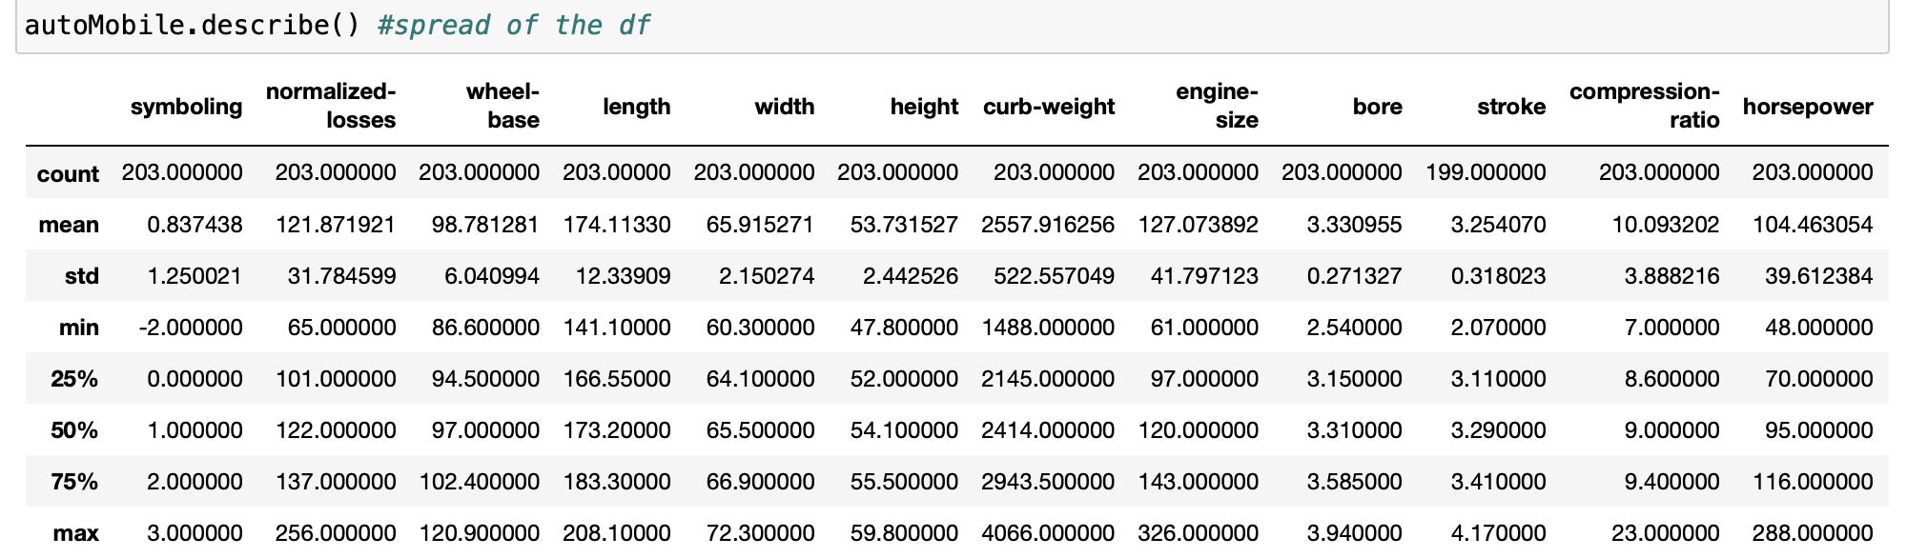
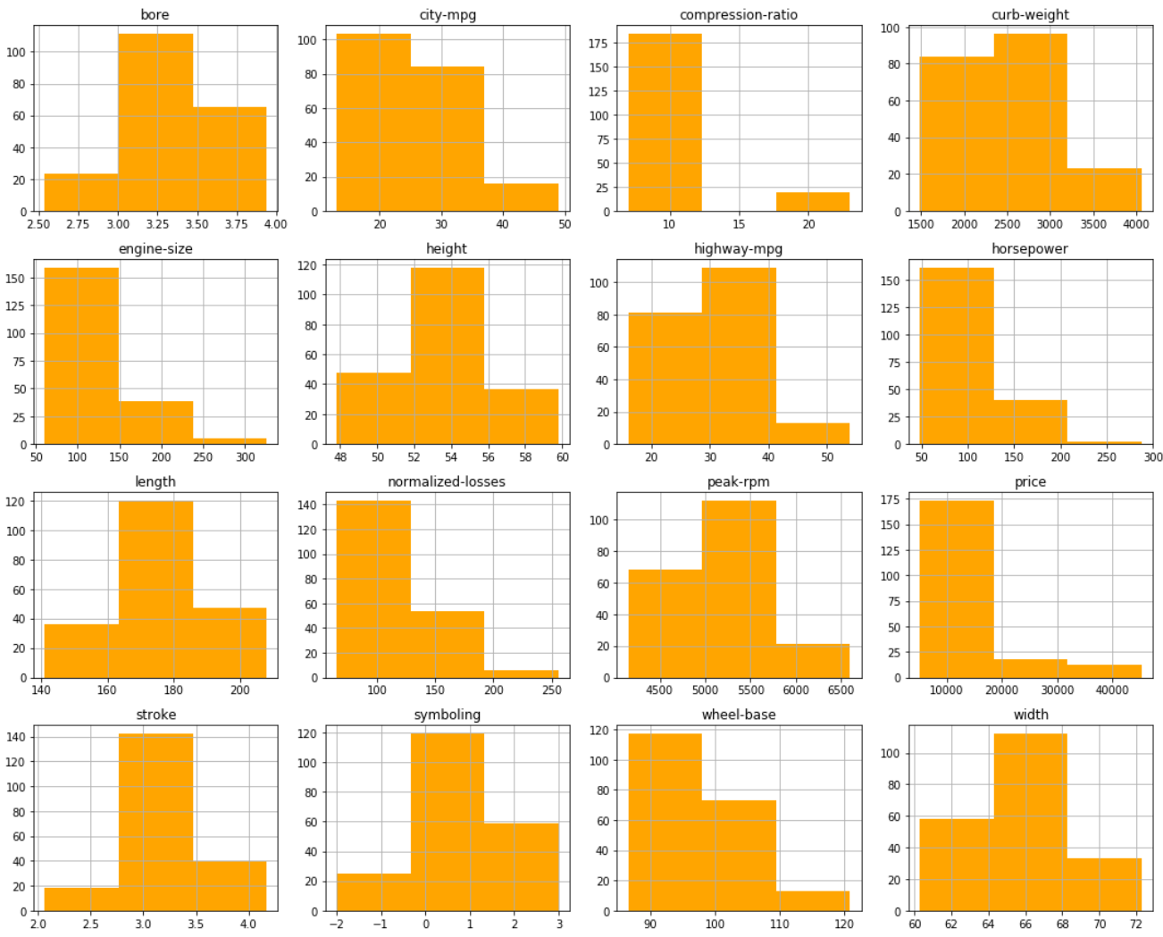
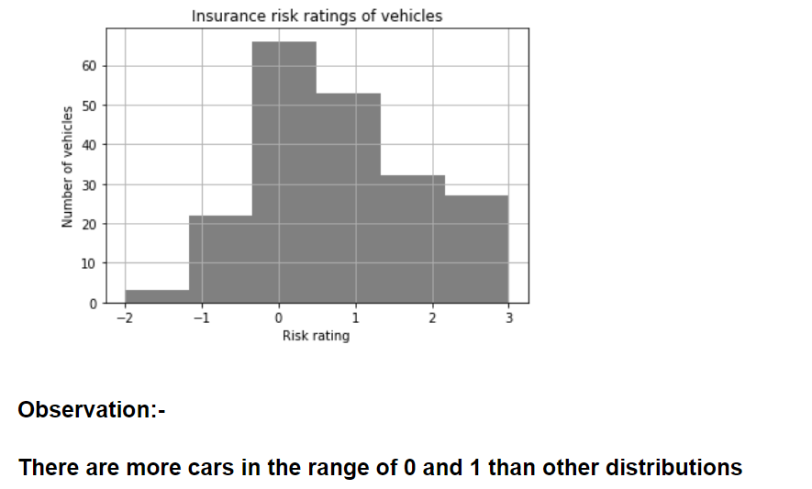
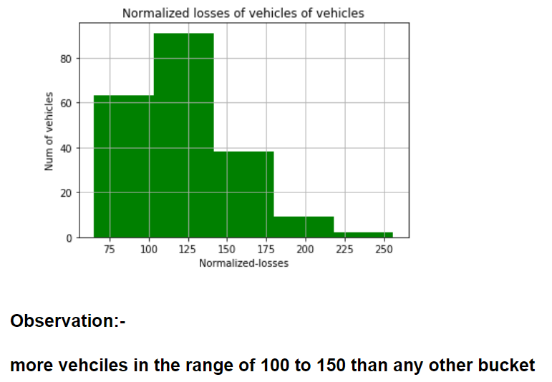
#A minimum of 5 variables in your dataset used during your analysis (for help with selecting, the author made his selection on page 6 of your book). Consider what you think could have an impact on your question – remember this is never perfect, so don’t be worried if you miss one (Chapter 1).
*** #Include a histogram of each of the 5 variables – in your summary and analysis, identify any outliers and explain the reasoning for them being outliers and how you believe they should be handled (Chapter 2).

Slide 6
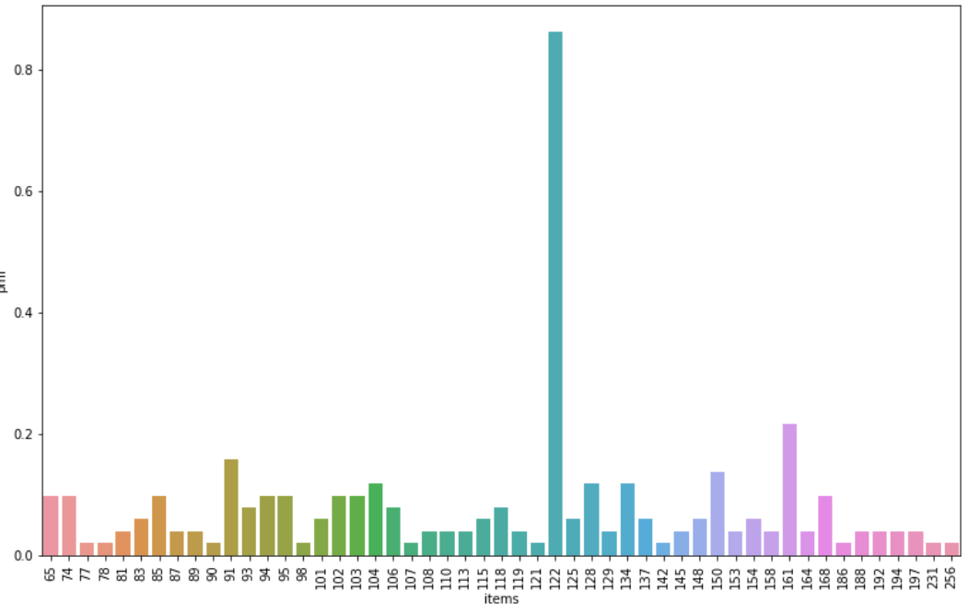
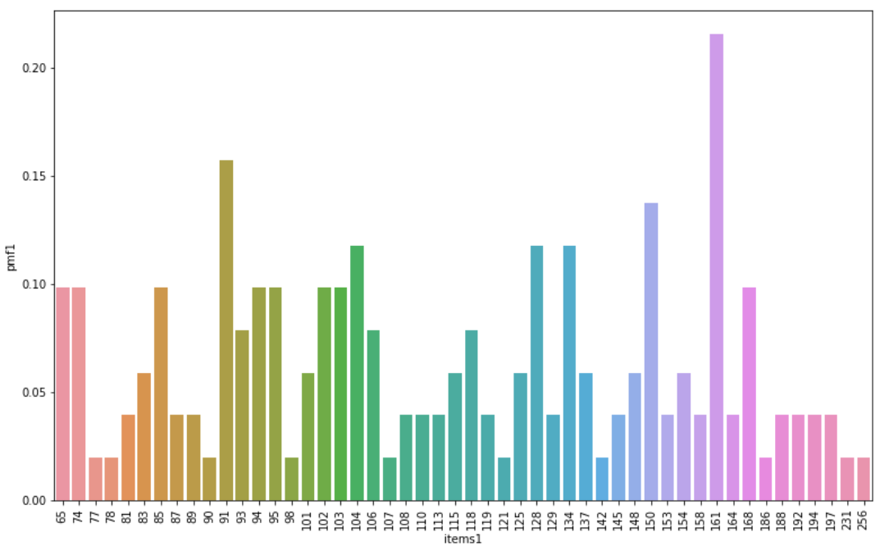
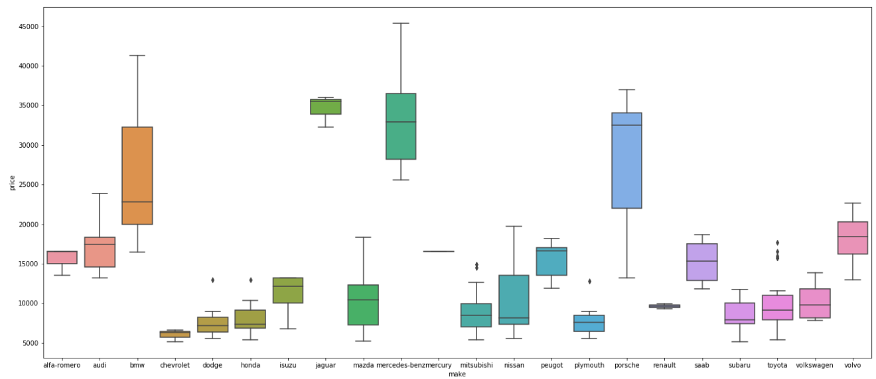
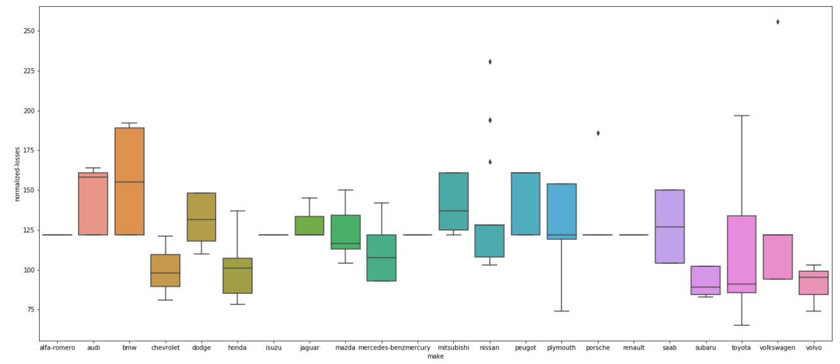
*** #Using pg. 29 of your text as an example, compare two scenarios in your data using a PMF. Reminder, this isn’t comparing two variables against each other – it is the same variable, but a different scenario. Almost like a filter.
Observation:-From the above two box plots, it is evident the Depreciation losses in use as compared to other cars are high for BMW,AUDI, Mistibushi ,SAAB and Peugot.¶
while Toyota , Honda, Chevrolet and volvo are depreciated quite less in the entire lot of cars.
From price of the car and to depreciation value, Mercedez-Benz wins well in high cost luxary cars

Slide 7
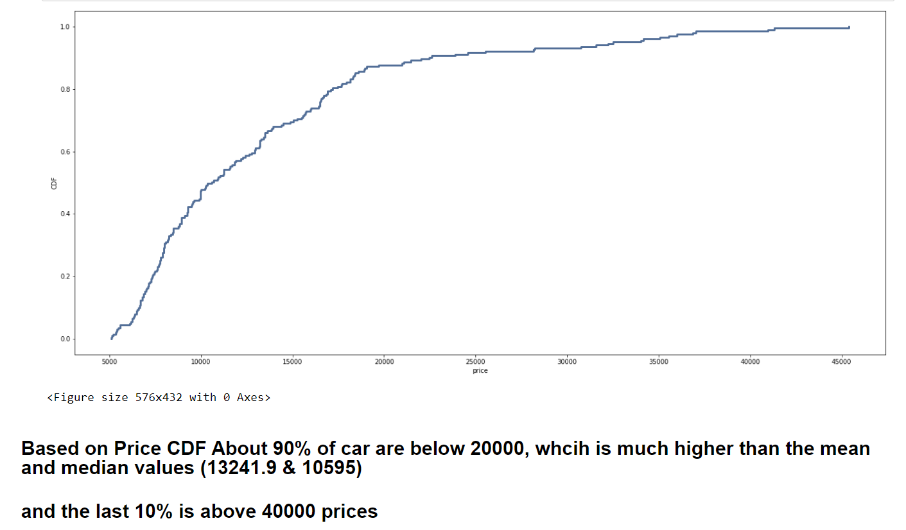
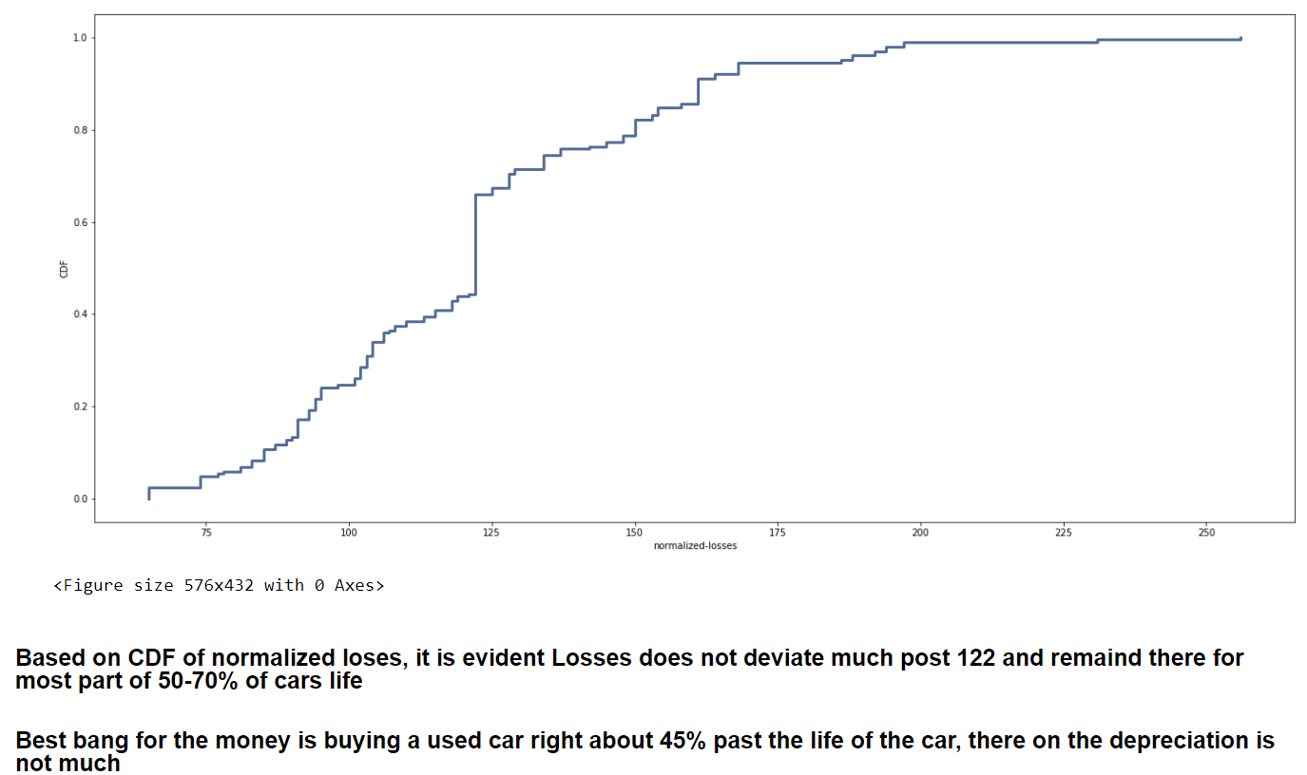
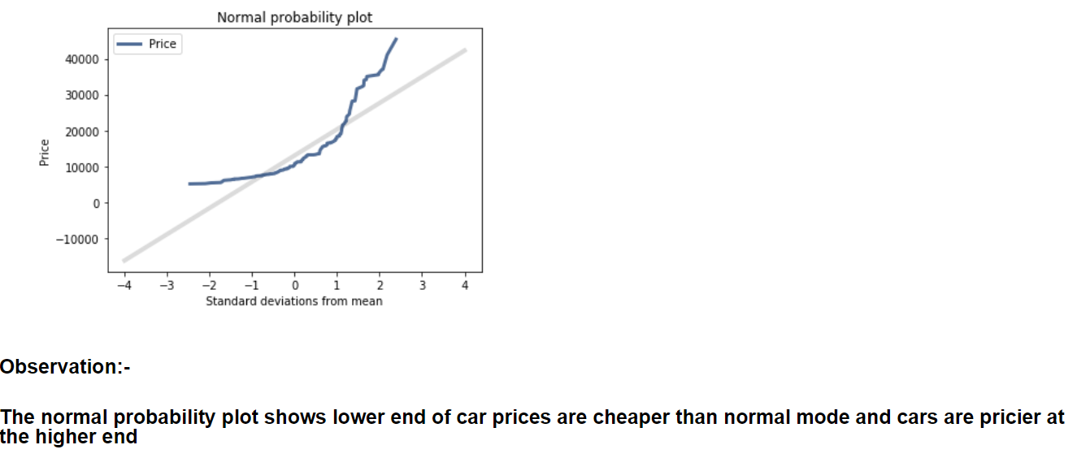
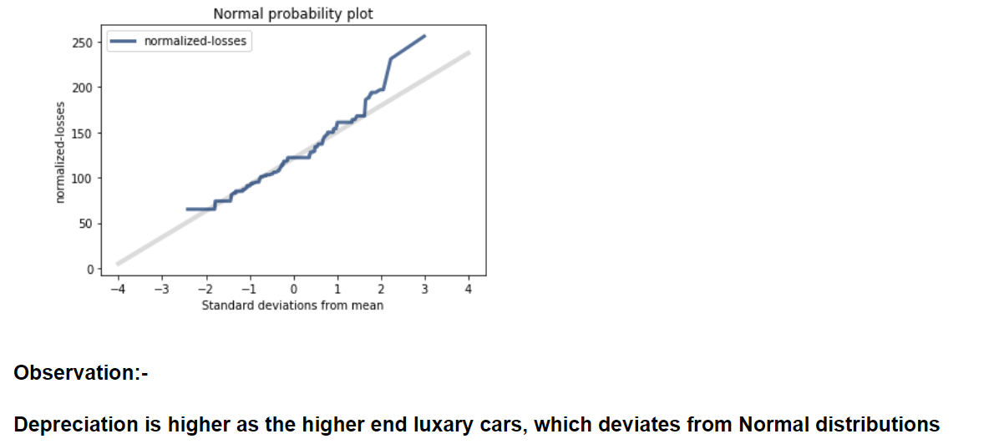
*** #Plot 1 analytical distribution and provide your analysis on how it applies to the dataset you have chosen (Chapter 5).

Slide 8
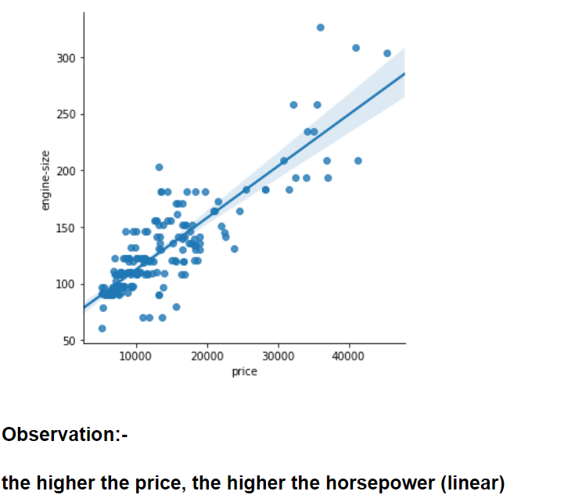
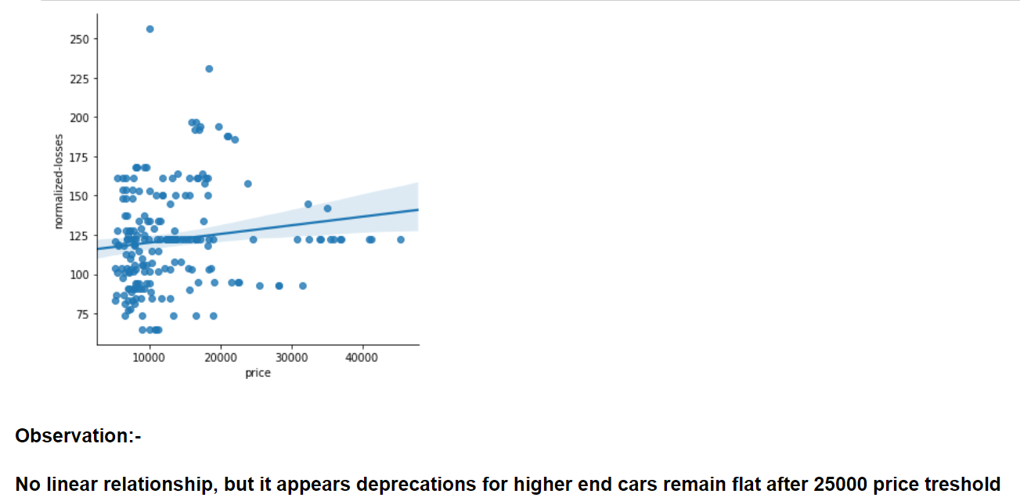
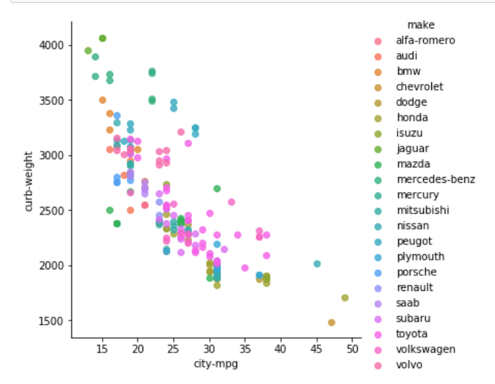
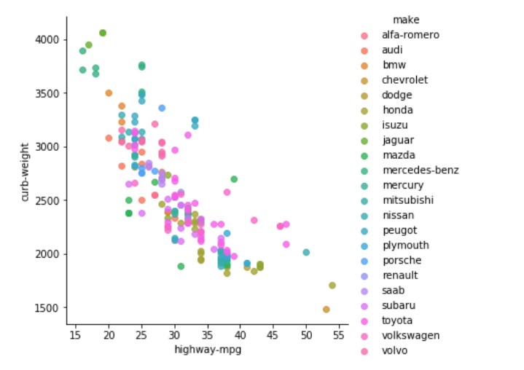
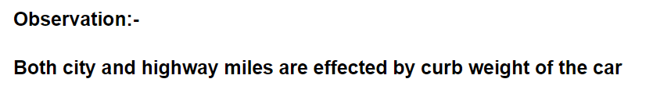
*** #Create two scatter plots comparing two variables and provide your analysis on correlation and causation.
#Remember, covariance, Pearson’s correlation, and Non-Linear Relationships should also be considered during your analysis (Chapter 7).

Slide 9
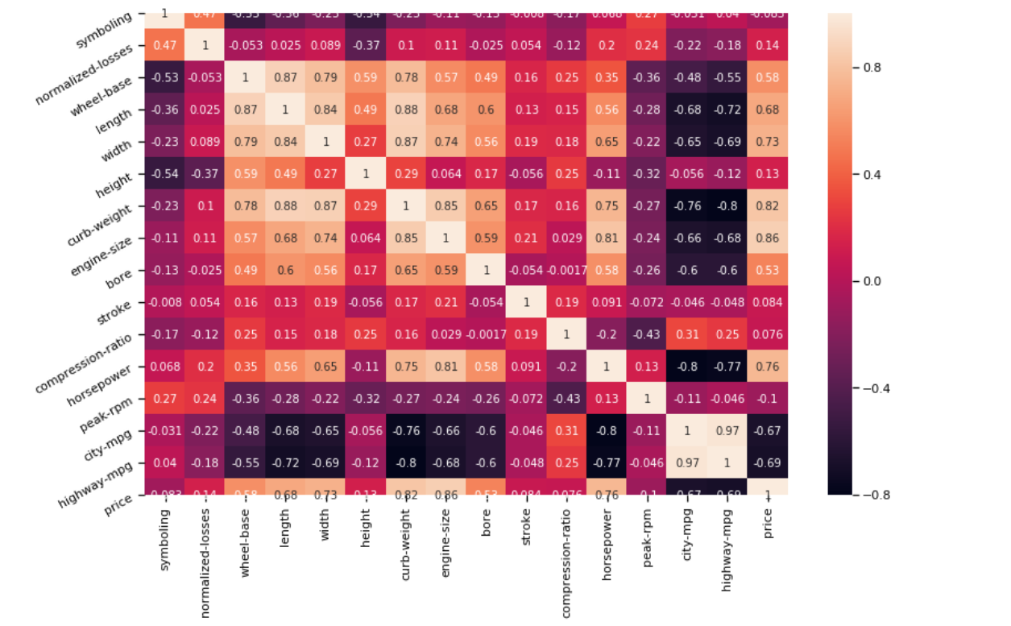
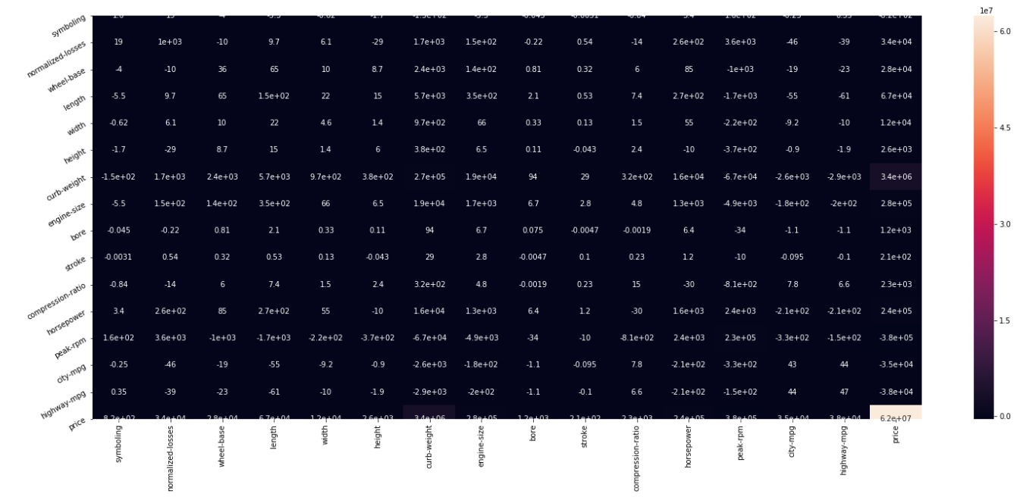
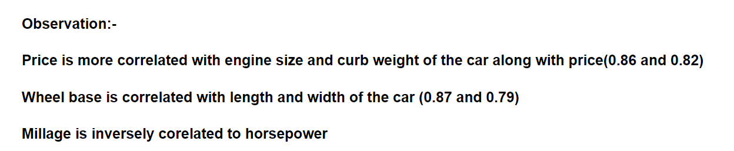

Slide 10
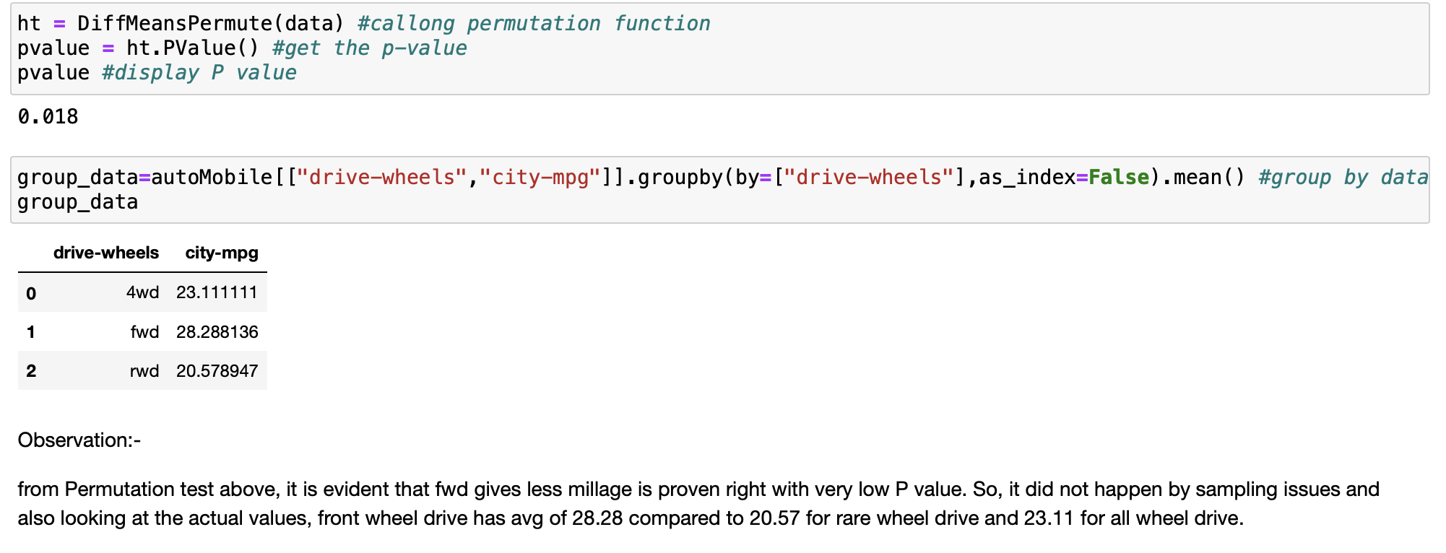
*** #Conduct a test on your hypothesis using one of the methods covered in Chapter 9.

Slide 11
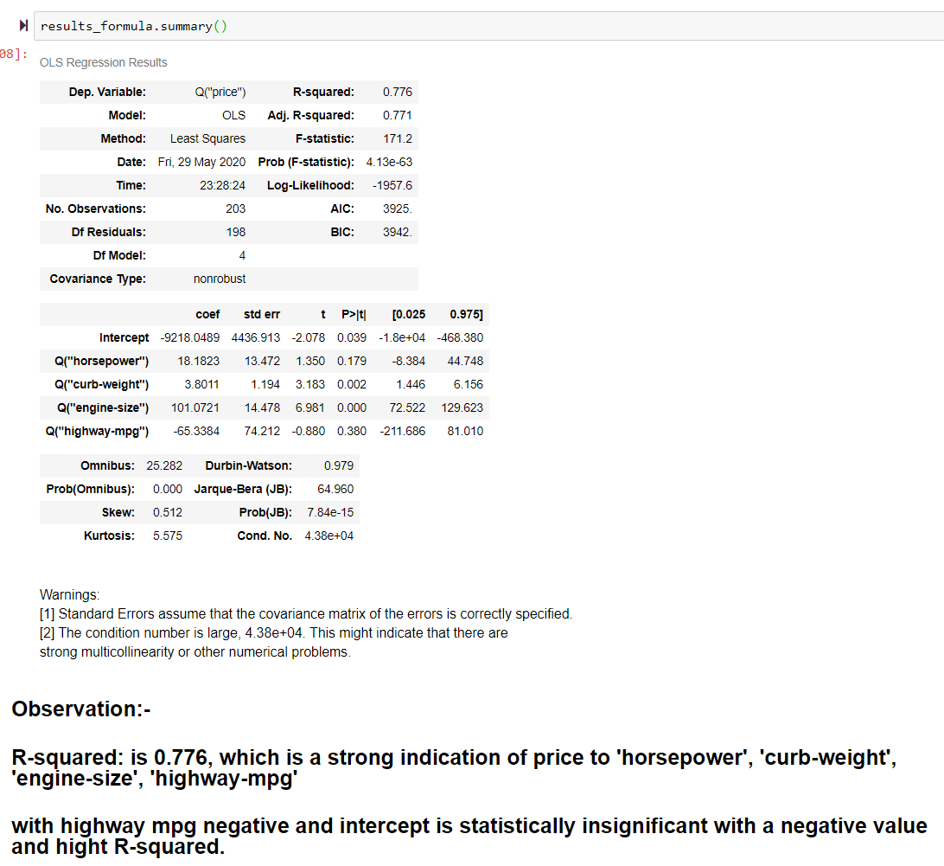
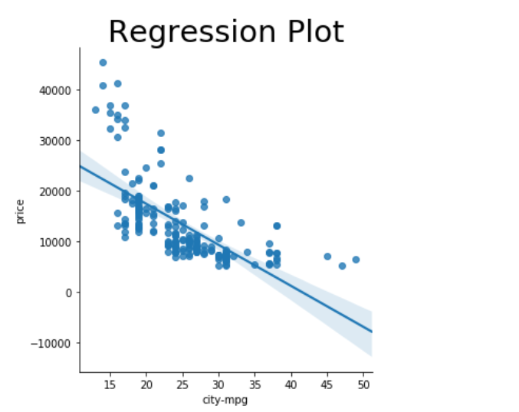
*** #For this project, conduct a regression analysis on either one dependent and one explanatory variable, or multiple explanatory variables (Chapter 10 & 11).

